Slide 1
Yarra River Corridor Planning Controls
Erin McCarthy – Coordinator Statutory Planning
Nick Brennan – Senior Strategic Planner

Slide 2
A brief history of Yarra Corridor Planning Controls
Pre-2005 – controls largely focused on environmental management, protection of vegetation and flood mitigation
C75 – Drafted by DSE/DPCD in 2005-7
Proposed a revised Environmental Significance Overlay (ESO) for the length of the River
Never implemented

Slide 3
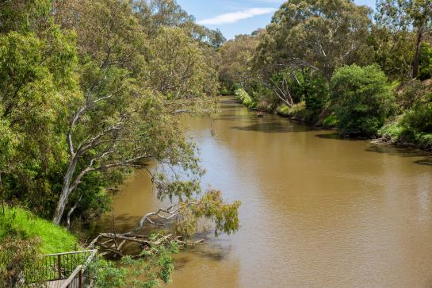
A brief history of Yarra Corridor Planning Controls
VC96 – October 2012
Introduced ESO1 and DDO31 on an interim basis
Approved by Minister Guy in response to planning application in Coppin Grove
These controls form the basis of the controls in place today

Slide 4
A brief history of Yarra Corridor Planning Controls
C210 – January 2015
Amendment created by Council
Converted the VC96 controls into permanent controls

Slide 5
A brief history of Yarra Corridor Planning Controls
VC121 – December 2015
Created in response to the Yarra Ministerial Advisory Committee process
Introduced revised and strengthened state planning policy regarding the Yarra River by relocating the River Corridor Policy from Clause 11 (settlements) to Clause 12 (Environment)
Signalled a change of focus from managing development to protecting the environment

Slide 6
A brief history of Yarra Corridor Planning Controls
GC48 – March 2017
Introduced new controls along the whole of the river on an interim basis
Revised controls in Boroondara to provide river bank setback requirements
Due to expire in January 2021

Slide 7
Purpose of the controls
DDO31 – provides guidance on building height, riverbank set backs, view lines, light spill, site coverage and permeability
SLO1 – provides guidance on vegetation removal and replanting, soil removal, fencing and overshadowing of the river

Slide 8
Yarra Structure Plan
Yarra Strategic Plan currently being prepared
Led by Melbourne Water with fifteen Councils and State Authorities collaborating
Lays out a ten year plan for the river corridor to achieve the 50 year community vision
Intending to go to public consultation following endorsement by all involved authorities

Slide 9
Review of planning controls
DELWP intending to carry out a review of the current controls following the completion of the Yarra Strategic Plan
Likely to include only minor changes, and to make controls permanent
Unknown at this stage if this will be a public process

Slide 10
A Statutory Planning Perspective
In Statutory Planning, since the introduction of the interim controls, we have not processed many planning permit applications of note in the areas affected by the overlays.
The one application that comes to mind is 12 Coppin Grove in Hawthorn, which as we are aware was the instigator of the new planning controls. This site provides a good case study to examine the assessment of the new controls.

Slide 11
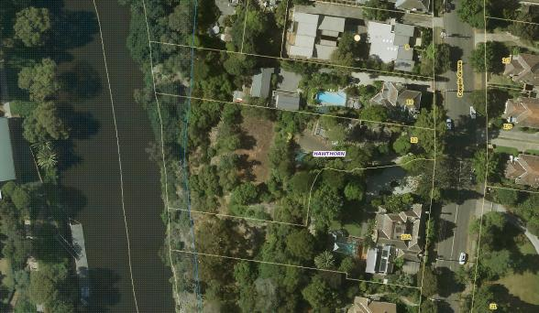
12 Coppin Grove, Hawthorn: A Case Study
The site is a large allotment located adjacent to the Yarra River on the western side of Coppin Grove, totalling 3273sqm in area.
The land slopes steeply towards the Yarra River and the land is heavily vegetated with a variety of species including indigenous, non-indigenous and weed species.
The site contains an existing residence historically described as the 'coach house‘, which was previously excised from the large Victorian-era dwelling known as 'Yarroma'.

Slide 12
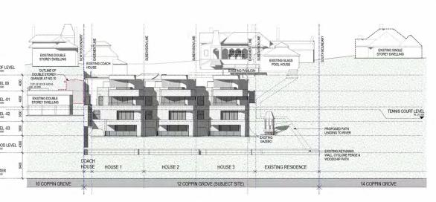
In 2011 – Proposal for 3 x 4 storey dwellings on a lot, behind the existing ‘coach house’ dwelling on the site
Opposed by Council and received 48 objections, including Melbourne Water
Heard by VCAT in October 2012 – part way through the hearing was the introduction of VC96, which introduced the mandatory height controls and therefore rendered the proposal prohibited
Elevation plan of the proposed 3 dwellings

Slide 13
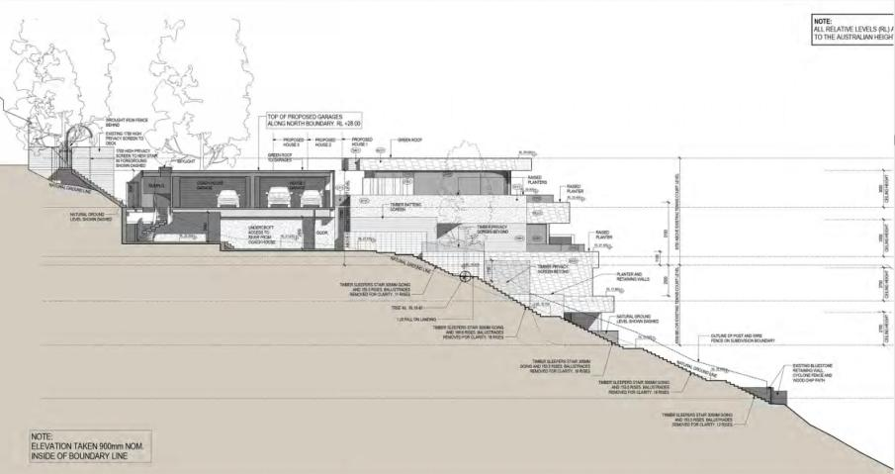
Side elevation plan of the proposed dwellings

Slide 14
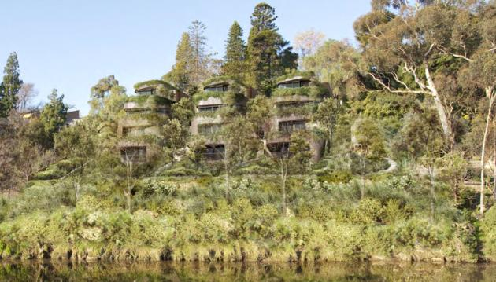
3D render of the proposed 3 dwellings viewed from the riverbank

Slide 15
Due to the gazettal of the amendment, the VCAT hearing was adjourned and the proposal revised to an additional 2 dwellings
VCAT ultimately determined to refuse the application
The land was subsequently sold and in 2013 a new application was made to construct 1 dwelling on the lot (behind the existing coach house dwelling)
This application was ultimately supported by the Council, due to the fact that the dwelling was to be constructed on the existing tennis court on the site and within the mandatory height and setback controls prescribed by the DDO31
The site then changed hands again and a new application was lodged for 1 additional dwelling on a lot in 2017
This application received 6 objections during advertising, including from the Yarra Riverkeeper
Notably, the applicant amended plans following advertising and all parties except one withdrew their objection

Slide 16
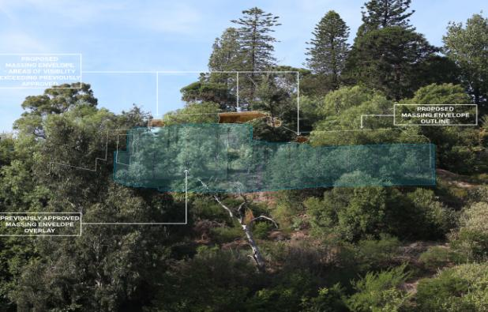
3D render of the current proposal

Slide 17
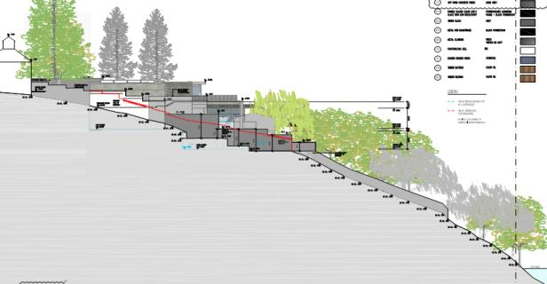
Comparison between original and current elevation plan
Previous plan
Current plan

Slide 18
As the comparison shows, the current proposal is well within the 30m setback requirement and the 9m height limit
No overshadowing of river or any public open space
Site coverage does not exceed 40% of total site area
Materials are complementary to landscaped setting
Retention of mature trees on site, even though not indigenous, which contribute to established landscaped character
This outcome is a direct result of the much more stringent, mandatory and measurable controls that have been introduced, which in time will work towards preventing more inappropriate development along the river’s banks.
This much more positive outcome is clearly evident when we compare the original proposal for 12 Coppin Grove and the proposal we have before us today
The current proposal also demonstrates the positive outcomes due to third party involvement, with all but one of the objectors withdrawing their objections. The result is a more sensitive and appropriate infill development that works with, and not against, the existing attributes of the river and its surrounds.
My hope is that now going forward, the controls are ingrained permanently and will therefore give us planners the tools to demand appropriate and respectful development to the River and the neighbourhood as a whole

